Slide 1
Integrated Measuring System - IMS for Ball and Roller Rail Systems Linear Motion Technology / DC-LT Matthias Wolf, DC-LT/SCO3
1
DC-LT/SCO3 | 14.01.2019
DC-LT/SCO3
© Bosch Rexroth AG 2019. All rights reserved, also regarding any disposal, exploitation, reproduction, editing, distribution, as well as in the event of applications for industrial property rights.

Slide 2
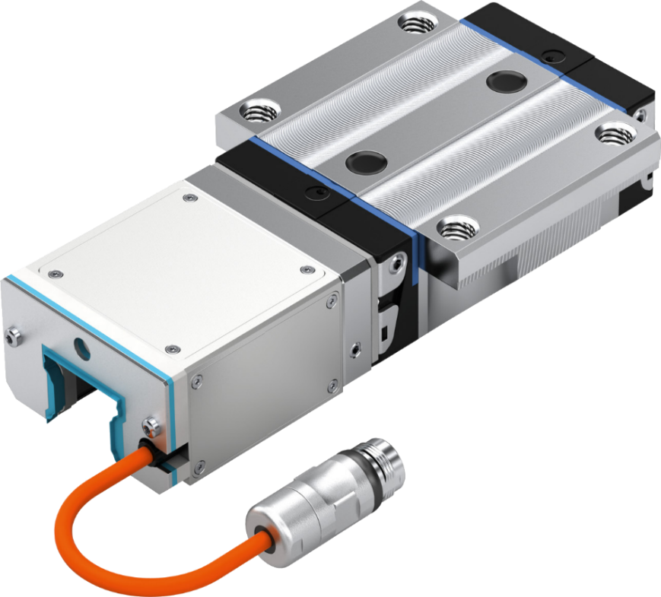
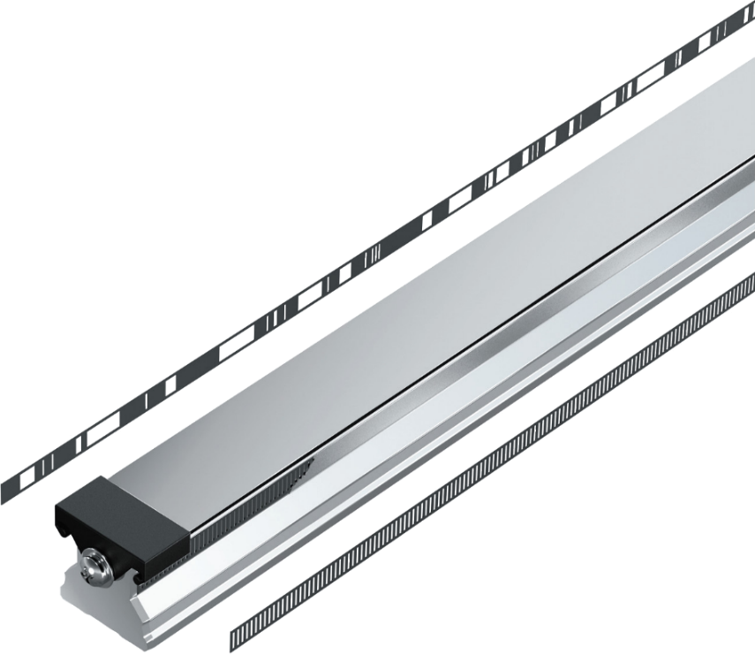
for ball rail and roller rail systems
Integrated Measuring System - IMS
DC-LT/SCO
IMS-A: Integrated Measuring System – Absolute
IMS-I: Integrated Measuring System - Incremental
2
DC-LT/SCO3 | 14.01.2019
DC-LT/SCO3
© Bosch Rexroth AG 2019. All rights reserved, also regarding any disposal, exploitation, reproduction, editing, distribution, as well as in the event of applications for industrial property rights.

Slide 3
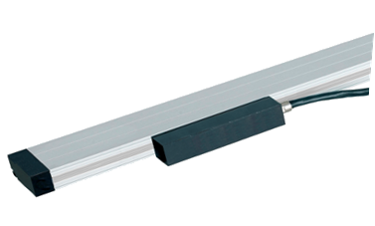
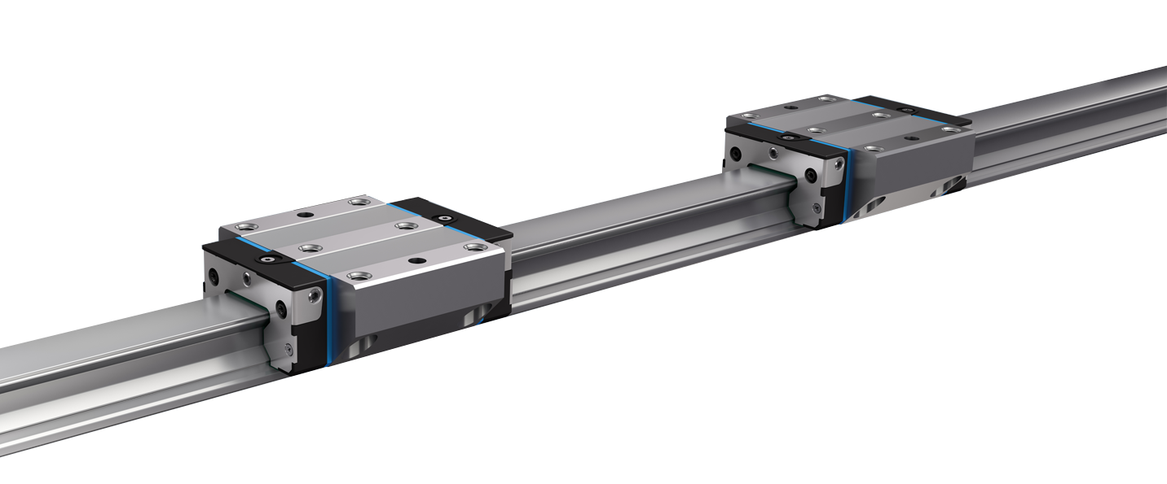
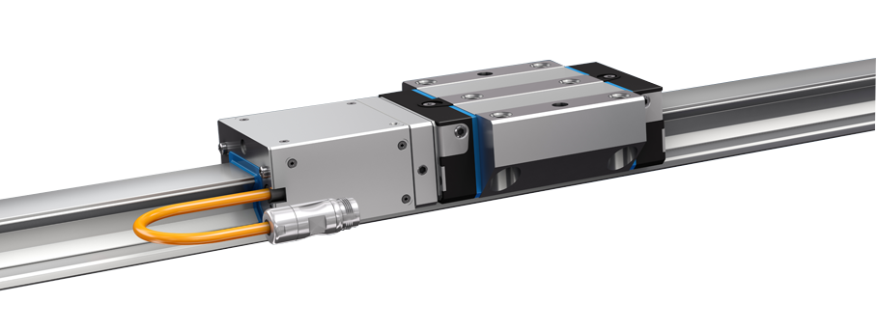
What is IMS?
Integrated Measuring System - IMS
DC-LT/SCO
Linear Encoder
IMS is a high precise and accurate measuring system.
With its full integration into the guide rail customers have new opportunities for cost efficient and simpler machine designs.
Due to the inductive measuring principle IMS has a never before seen robustness and resistance in harsh environments.
Linear guide
IMS
3
DC-LT/SCO3 | 14.01.2019
DC-LT/SCO3
© Bosch Rexroth AG 2019. All rights reserved, also regarding any disposal, exploitation, reproduction, editing, distribution, as well as in the event of applications for industrial property rights.

Slide 4
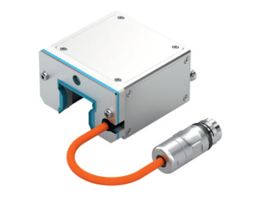
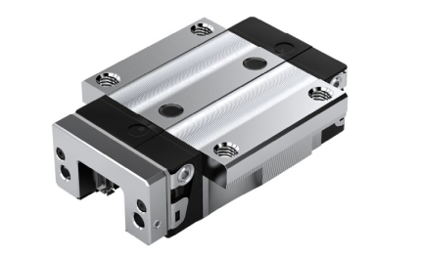
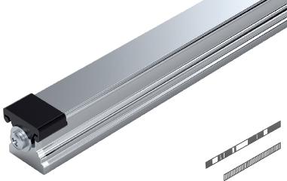
Components
Integrated Measuring System - IMS
DC-LT/SCO
Measuring Head (Scanner)
Including sensors, electronics, connection cables and connector
Ready-mounted on the runner block
Ball- or Roller-Runner-Block
(with mounted adapter plate)
Available in:
different sizes
different accuracy classes
different preloading classes
Guide Rail
with integrated, incremental scale
with integrated absolute code band (IMS-A)
with integrated reference marks (IMS-I)
with cover strip or plastic/steel caps
The integration of the measuring system in the linear guide results in a mechatronic system which combines the functions of guiding mechanical loads and measuring of absolute positions in a single product.
4
DC-LT/SCO3 | 14.01.2019
DC-LT/SCO3
© Bosch Rexroth AG 2019. All rights reserved, also regarding any disposal, exploitation, reproduction, editing, distribution, as well as in the event of applications for industrial property rights.

Slide 5
External linear encoders (e.g. glass scales) are not needed anymore!
DC-LT/SCO
5
DC-LT/SCO3 | 14.01.2019
DC-LT/SCO3
© Bosch Rexroth AG 2019. All rights reserved, also regarding any disposal, exploitation, reproduction, editing, distribution, as well as in the event of applications for industrial property rights.

Slide 6
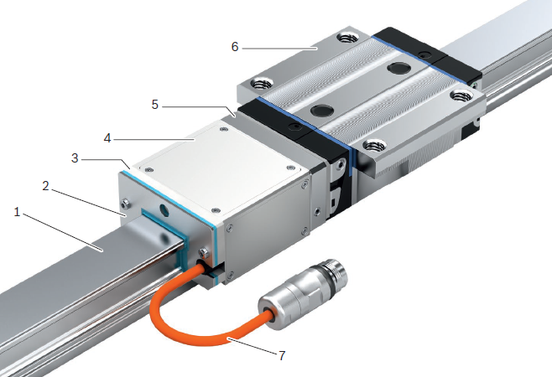
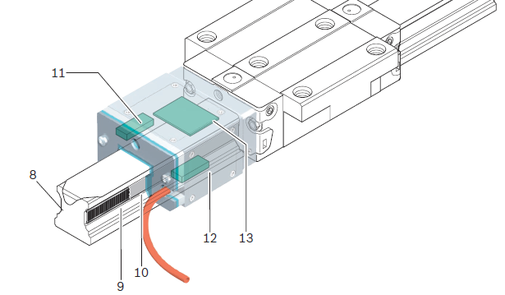
Design
Integrated Measuring System - IMS
DC-LT/SCO
1 Guide rail with scale, reference marks or absolute code band
2 End seal
3 Support plate
4 Scanner
5 Adapter plate (fixed to the runner block)
6 Runner block
7 Cable and connector
8 Reference marks (IMS-I) or absolute code band (IMS-A)
9 Incremental scale pitch
10 Scale protection via laser-welded stainless steel strip
11 Sensor for reference marks (IMS-I) or absolute code band (IMS-A)
12 Measuring sensor
13 Evaluation electronics
6
DC-LT/SCO3 | 14.01.2019
DC-LT/SCO3
© Bosch Rexroth AG 2019. All rights reserved, also regarding any disposal, exploitation, reproduction, editing, distribution, as well as in the event of applications for industrial property rights.

Slide 7
Design – IMS rail construction
Integrated Measuring System - IMS
DC-LT/SCO
Position element
Linear scale
1000 µm
Incremental scale
Single reference mark
IMS-I
Absolut code band IMS-A
7
DC-LT/SCO3 | 14.01.2019
DC-LT/SCO3
© Bosch Rexroth AG 2019. All rights reserved, also regarding any disposal, exploitation, reproduction, editing, distribution, as well as in the event of applications for industrial property rights.

Slide 8
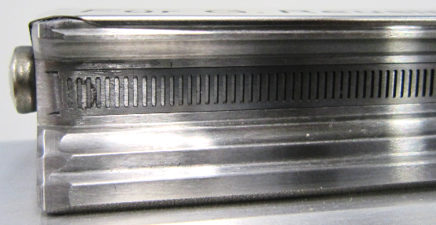
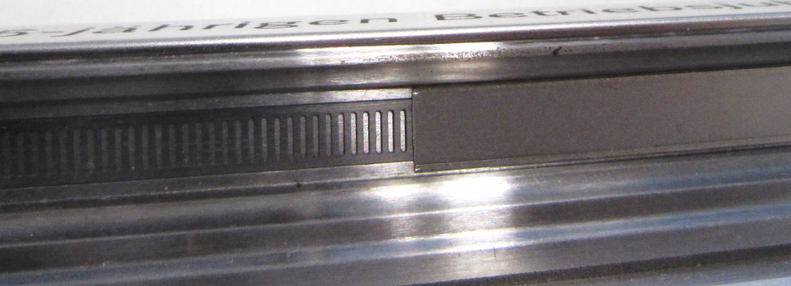
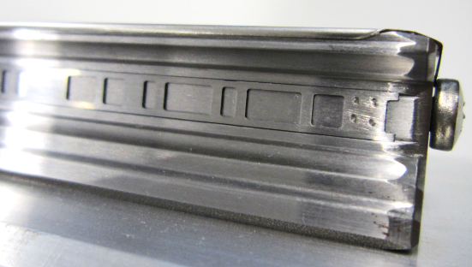
Design – IMS rail construction
Integrated Measuring System - IMS
DC-LT/SCO
The scales are welded on both ends to the rail. The scales do have a slight tension.
For protection, a stainless steel strip covers the scales over the entire length. Through the steel strip a complete tightness is achieved.
Spot welding of scales
Stainless steel strip (laser welded, protected IP67)
8
DC-LT/SCO3 | 14.01.2019
DC-LT/SCO3
© Bosch Rexroth AG 2019. All rights reserved, also regarding any disposal, exploitation, reproduction, editing, distribution, as well as in the event of applications for industrial property rights.

Slide 9
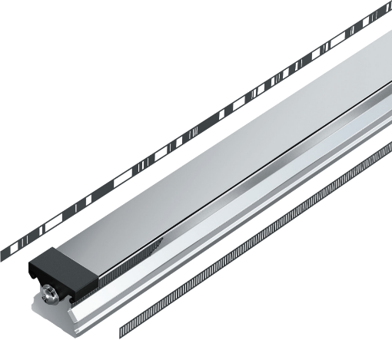
Design – incremental, inductive Sensor
Integrated Measuring System - IMS
DC-LT/SCO
primary windings
Micro inductor structure
Micro inductor structure
secundary windings
Sensor substrate
Incremental scale (steel)
9
DC-LT/SCO3 | 14.01.2019
DC-LT/SCO3
© Bosch Rexroth AG 2019. All rights reserved, also regarding any disposal, exploitation, reproduction, editing, distribution, as well as in the event of applications for industrial property rights.

Slide 10
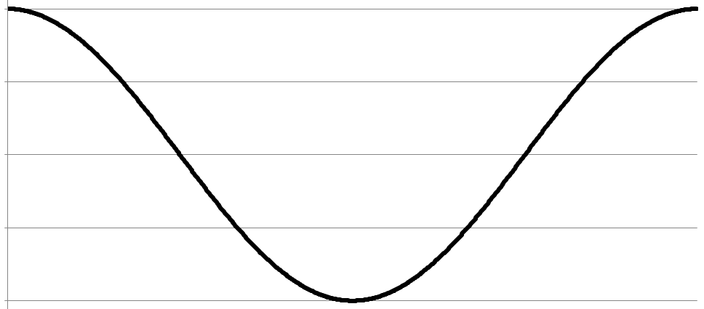
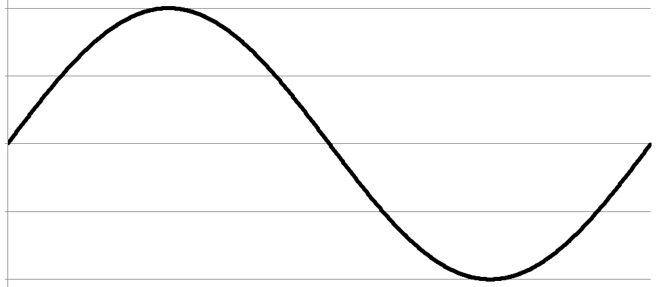

Design – signal sequence of incremental sensor
Integrated Measuring System - IMS
DC-LT/SCO
Signals
ChB
x (stroke)
ChA
1mm
10
DC-LT/SCO3 | 14.01.2019
DC-LT/SCO3
© Bosch Rexroth AG 2019. All rights reserved, also regarding any disposal, exploitation, reproduction, editing, distribution, as well as in the event of applications for industrial property rights.

Slide 11
Design – angle-clock and interpolation
Integrated Measuring System - IMS
DC-LT/SCO
Angle-Clock
1mm is equal to 360° / 2π
Position within 1mm equates to angel α
α is calculable by arc tangent function
Interpolation
Signals ChA and ChB do have a very high resolution
α is very precise
Position could be calculated within 1mm better than 1 micron
ChB
α
ChA
1mm
11
DC-LT/SCO3 | 14.01.2019
DC-LT/SCO3
© Bosch Rexroth AG 2019. All rights reserved, also regarding any disposal, exploitation, reproduction, editing, distribution, as well as in the event of applications for industrial property rights.

Slide 12
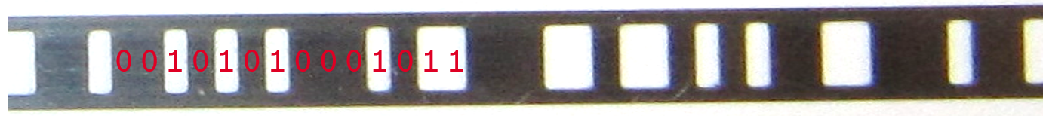
Design – absolute code band
Integrated Measuring System - IMS
DC-LT/SCO
Binary representation: bar = 0, hole = 1
The absolute code band has a so called “Pseudo-Random-Bit-Sequence”. This allows the explicit calculation of the absolute position from any 14 sequenced bits over the entire measuring length.
Source: Wikipedia
12
DC-LT/SCO3 | 14.01.2019
DC-LT/SCO3
© Bosch Rexroth AG 2019. All rights reserved, also regarding any disposal, exploitation, reproduction, editing, distribution, as well as in the event of applications for industrial property rights.

Slide 13
Inductive measuring principle enables contactless position measurement.
The IMS measuring function is free of wear and maintenance, also under following conditions……..
DC-LT/SCO
13
DC-LT/SCO3 | 14.01.2019
DC-LT/SCO3
© Bosch Rexroth AG 2019. All rights reserved, also regarding any disposal, exploitation, reproduction, editing, distribution, as well as in the event of applications for industrial property rights.

Slide 14
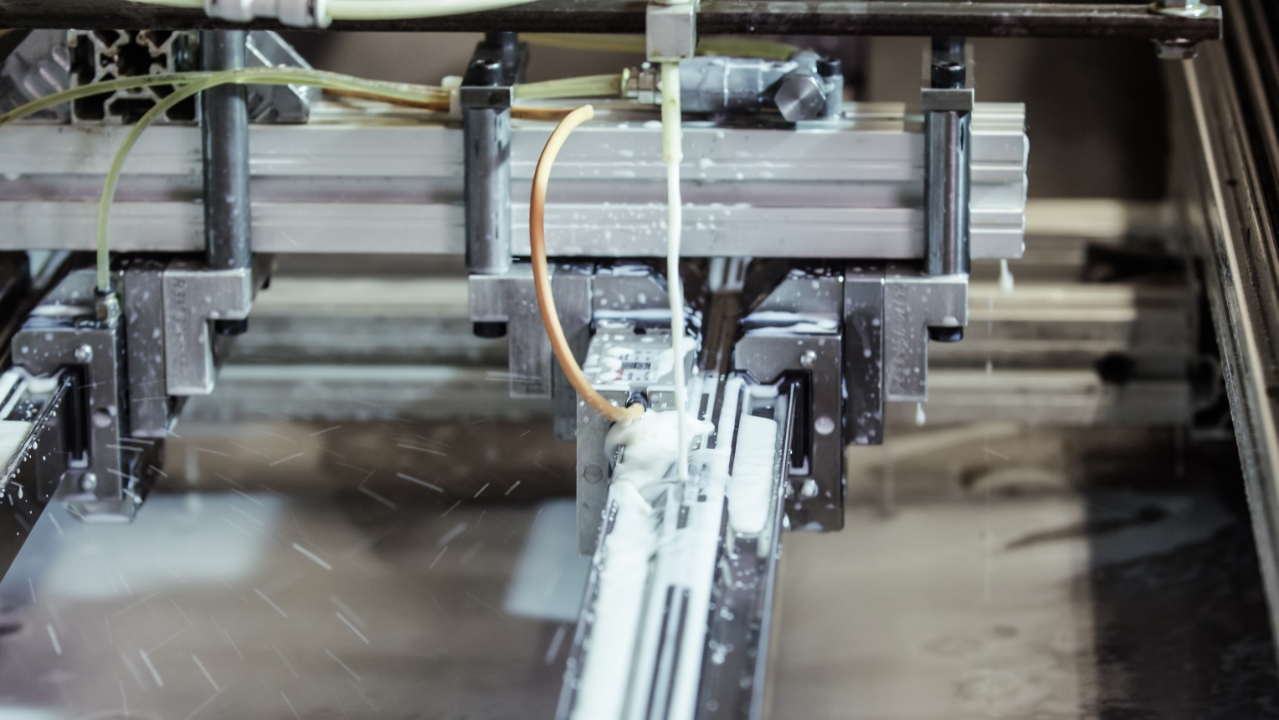
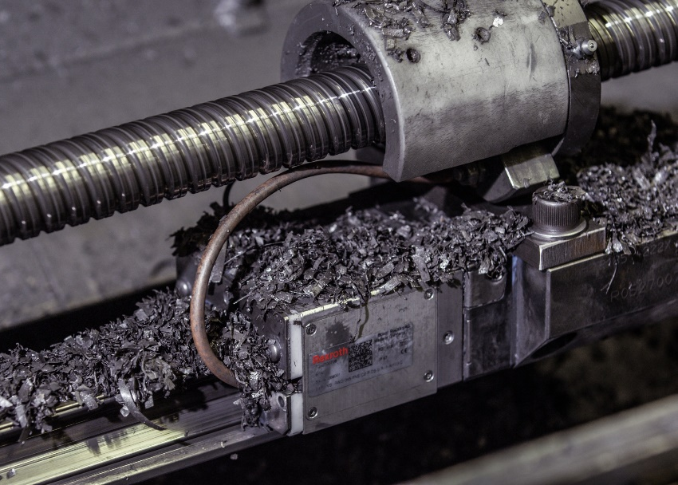
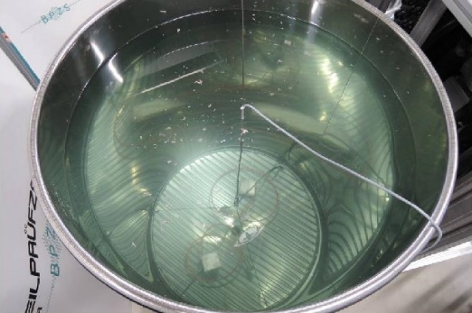
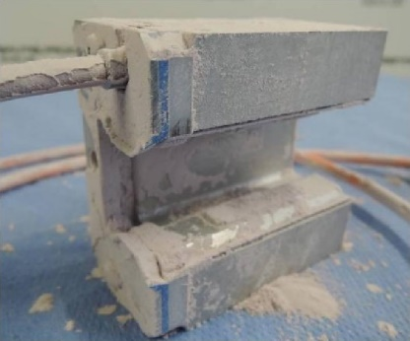
Robustness
Integrated Measuring System - IMS
DC-LT/SCO
IP67 test with water and
additionally with Curtis S90
IP67 dust-testing and additionally
800km in metal chip test drum
14
DC-LT/SCO3 | 14.01.2019
DC-LT/SCO3
© Bosch Rexroth AG 2019. All rights reserved, also regarding any disposal, exploitation, reproduction, editing, distribution, as well as in the event of applications for industrial property rights.

Slide 15
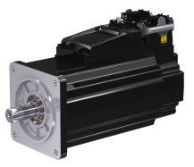
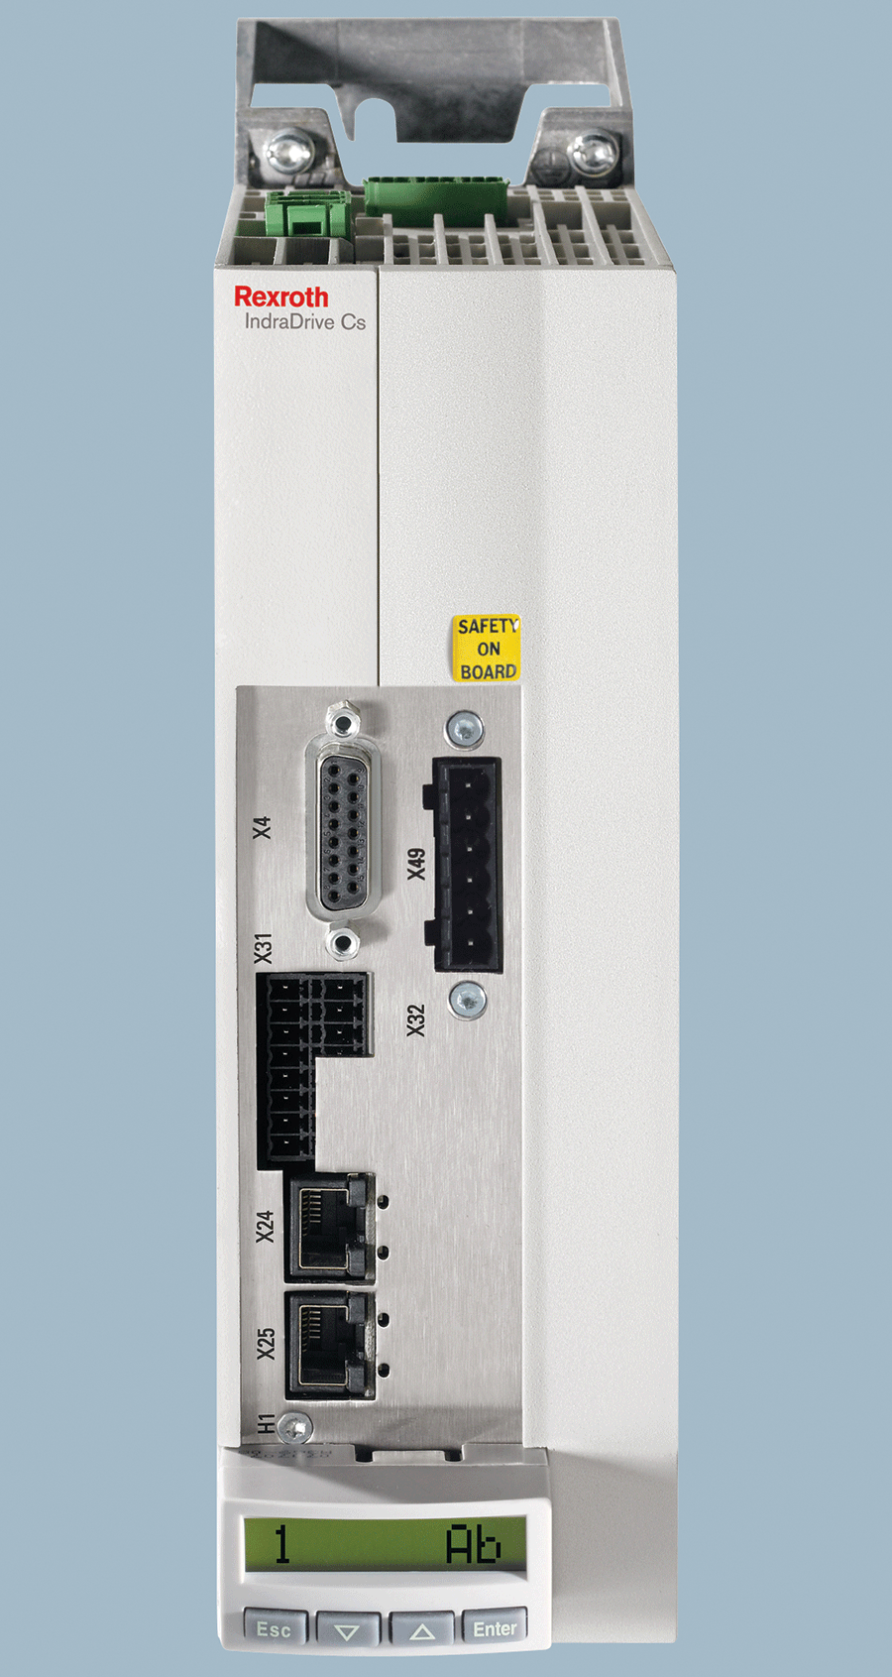
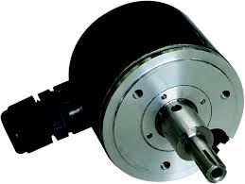
Why IMS?
Integrated Measuring System - IMS
DC-LT/SCO
For every positioning task the axis drive servomotor needs an additional encoder, which provides the actual position for the drive control system.
Servomotor
Drive Control System
Encoder / Measuring System
15
DC-LT/SCO3 | 14.01.2019
DC-LT/SCO3
© Bosch Rexroth AG 2019. All rights reserved, also regarding any disposal, exploitation, reproduction, editing, distribution, as well as in the event of applications for industrial property rights.

Slide 16
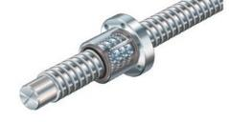
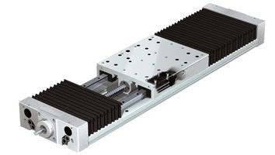
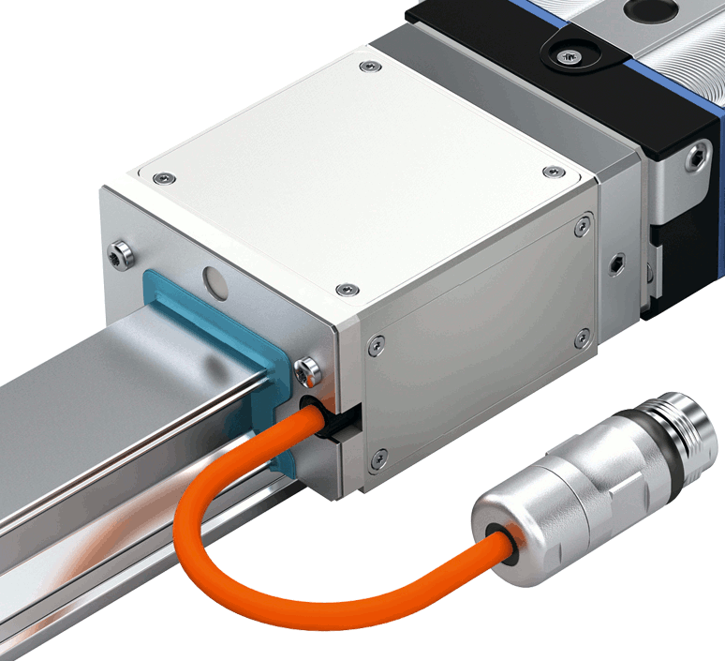
Why IMS?
Integrated Measuring System - IMS
DC-LT/SCO
Semi-Closed Loop Control
<-> Closed Loop Control
Current Position
Required Position
-
Measured Position
Indirectly Measured Position
Directly Measured Position
Heidenhain-TV on YouTube: https://youtu.be/IZxeJ6sPaOw
16
DC-LT/SCO3 | 14.01.2019
DC-LT/SCO3
© Bosch Rexroth AG 2019. All rights reserved, also regarding any disposal, exploitation, reproduction, editing, distribution, as well as in the event of applications for industrial property rights.

Slide 17
Why IMS?
Integrated Measuring System - IMS
DC-LT/SCO
Highlights:
Advantages:
Your Benefits:
Absolute measuring system
absolute position information immediately after system power on
no battery required compared to competition
Power up without referencing movement minimizes machine run-up time and prevents damages to the tool and work piece
Inductive measuring principle
wear- and maintenance-free
not sensitive to dirt and vibrations
not sensitive to EMC interference
no magnetic components
High level of reliability and reduced
downtimes of your machines
Highly precise position resolution and repeatability
exact positioning
excellent control loop dynamics
very low path deviation
Excellent machine accuracy
Excellent work piece quality
Complete integration into linear guide
minimum assembly time
no adjustments for measuring system
very good protection against damage
high robustness and stiffness
Cost advantage due to time savings in terms of design, assembly, commissioning and service
17
DC-LT/SCO3 | 14.01.2019
DC-LT/SCO3
© Bosch Rexroth AG 2019. All rights reserved, also regarding any disposal, exploitation, reproduction, editing, distribution, as well as in the event of applications for industrial property rights.

Slide 18
By mounting the linear guide, the linear encoder for position measurement is already installed.
It is plug and play – no further measures are necessary!
DC-LT/SCO
18
DC-LT/SCO3 | 14.01.2019
DC-LT/SCO3
© Bosch Rexroth AG 2019. All rights reserved, also regarding any disposal, exploitation, reproduction, editing, distribution, as well as in the event of applications for industrial property rights.

Slide 19
Product Portfolio: Accuracies
Integrated Measuring System - IMS
DC-LT/SCO
Scale Accuracy | Up to ±3µm/m
Repeatability | ± 0,25µm
Interpolation Accuracy | ± 0,75µm
Position Value Resolution | Up to 0,025µm
19
DC-LT/SCO3 | 14.01.2019
DC-LT/SCO3
© Bosch Rexroth AG 2019. All rights reserved, also regarding any disposal, exploitation, reproduction, editing, distribution, as well as in the event of applications for industrial property rights.

Slide 20
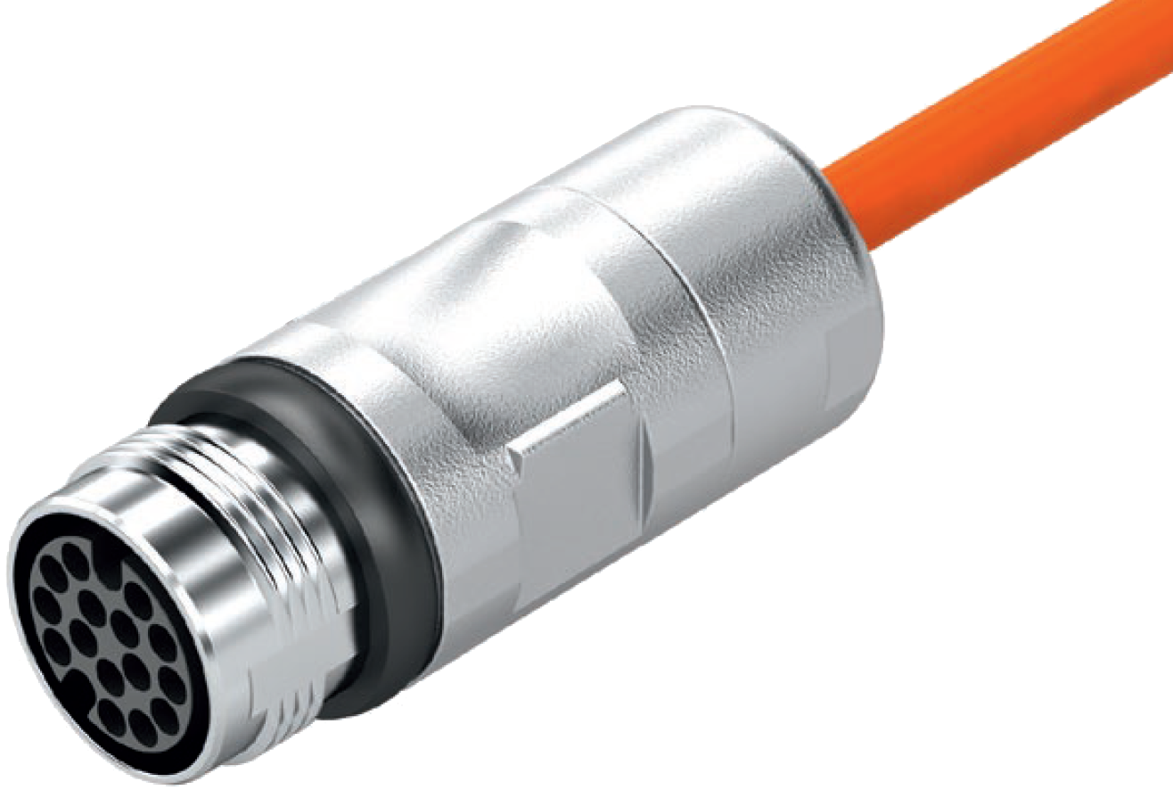
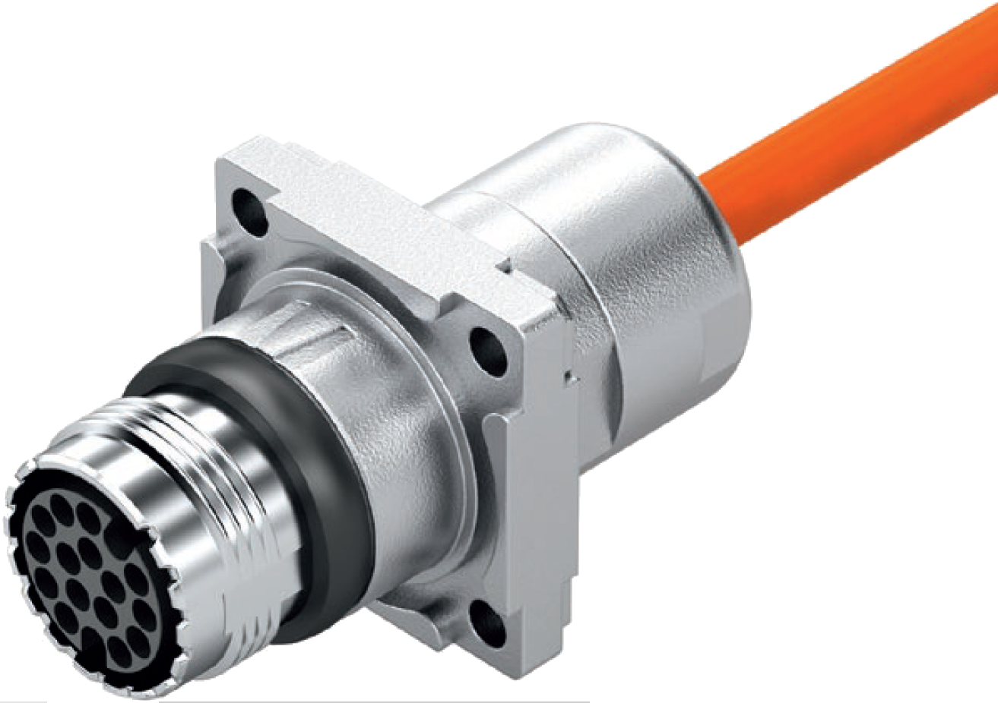

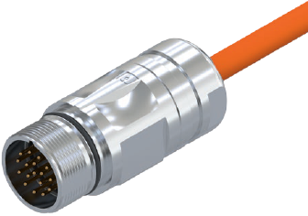

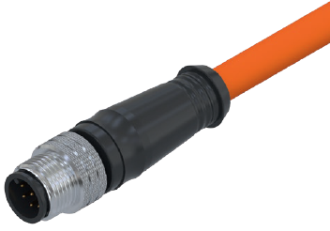

Product Portfolio: Interfaces IMS-A
Integrated Measuring System - IMS
DC-LT/SCO
IP67 protection
M17 / 17-Pin
IP67 protection
Fits to standard FANUC connectors
M23 / 17-Pin
IP67 protection
Fits SIEMENS MOTION-CONNECT accessories
20
DC-LT/SCO3 | 14.01.2019
DC-LT/SCO3
© Bosch Rexroth AG 2019. All rights reserved, also regarding any disposal, exploitation, reproduction, editing, distribution, as well as in the event of applications for industrial property rights.

Slide 21
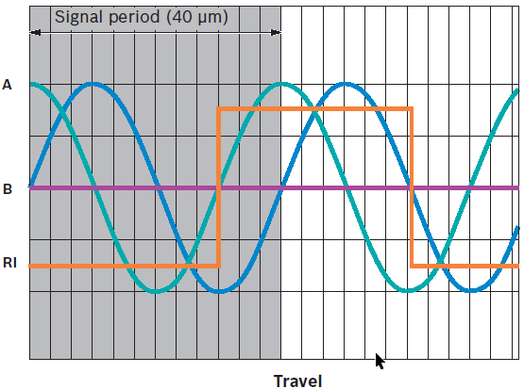
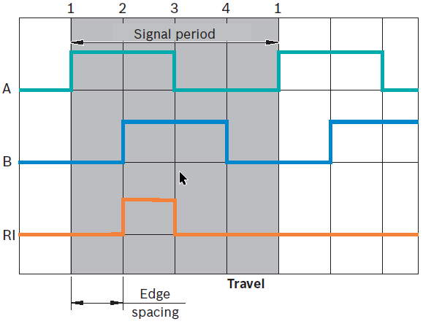
Product Portfolio: Interfaces IMS-I
Integrated Measuring System - IMS
DC-LT/SCO
1Vpp / 40µm
IP67 protection
TTL 1µm,
TTL 5µm
TTL 10µm
M17 / 17-Pin
21
DC-LT/SCO3 | 14.01.2019
DC-LT/SCO3
© Bosch Rexroth AG 2019. All rights reserved, also regarding any disposal, exploitation, reproduction, editing, distribution, as well as in the event of applications for industrial property rights.

Slide 22
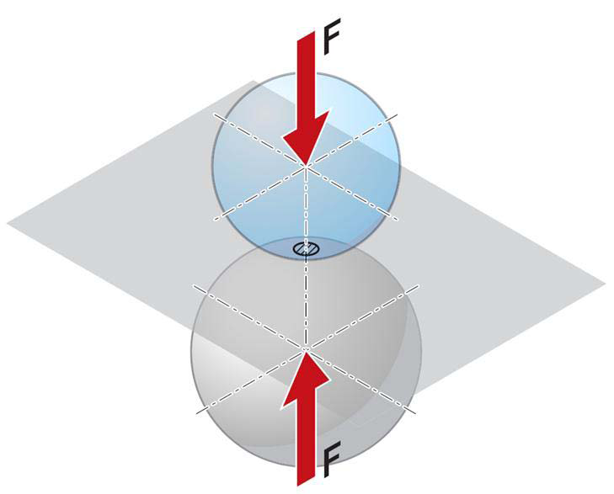
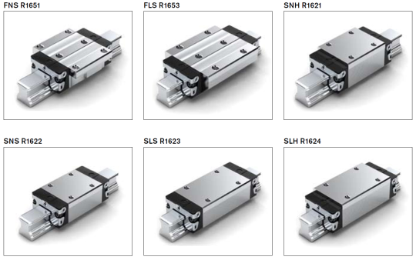
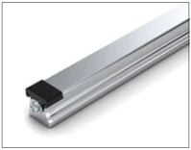
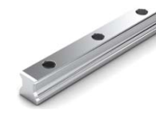
Product Portfolio – Ball Rail System
Integrated Measuring System - IMS
DC-LT/SCO
Size: | 20 / 25 / 30 / 35 / 45
Preload: | C1 / C2 / C3
Accuracy : | P / SP
Ball Chain: | without / with
Mounting Side: | right / left
Type: | SNS – Standard
Mounting: | from above
Accuracy: | ± 3 µm/m and ± 5 µm/m @ 20°C
Length: | up to 4500 mm
22
DC-LT/SCO3 | 14.01.2019
DC-LT/SCO3
© Bosch Rexroth AG 2019. All rights reserved, also regarding any disposal, exploitation, reproduction, editing, distribution, as well as in the event of applications for industrial property rights.

Slide 23
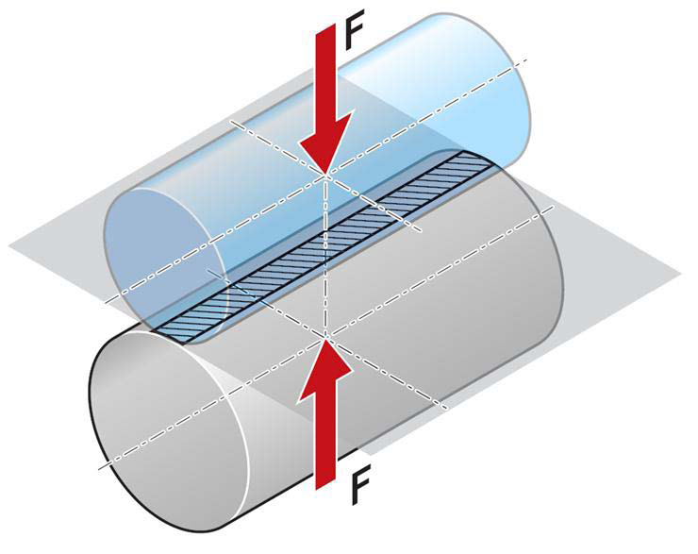
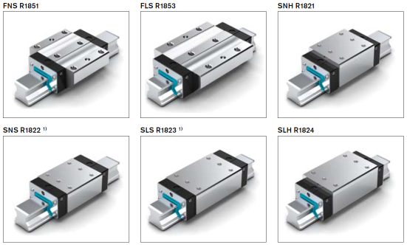
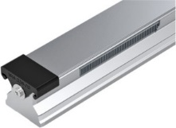
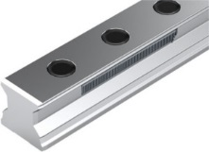
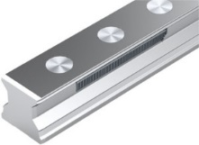
Product Portfolio – Roller Rail System
Integrated Measuring System - IMS
DC-LT/SCO
Size: | 35 / 45 / 55 / 65
Preload: | C2 / C3
Accuracy: | P / SP
Mounting Side: | right / left
Type: | SNS – Standard
Mounting: | from above
Accuracy: | ± 3 µm/m and ± 5 µm/m @ 20°C
Length: | up to 4000 mm
23
DC-LT/SCO3 | 14.01.2019
DC-LT/SCO3
© Bosch Rexroth AG 2019. All rights reserved, also regarding any disposal, exploitation, reproduction, editing, distribution, as well as in the event of applications for industrial property rights.

Slide 24
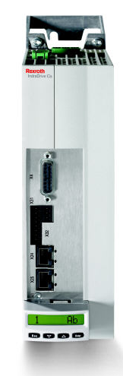
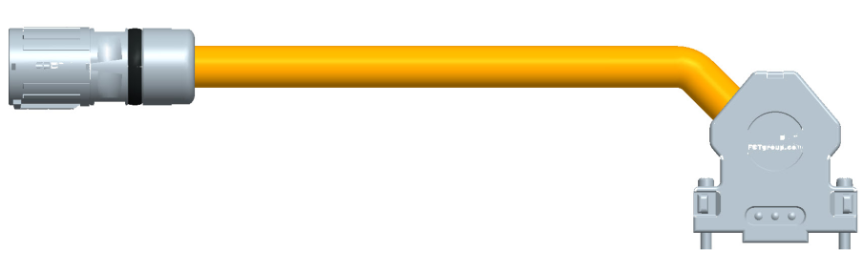
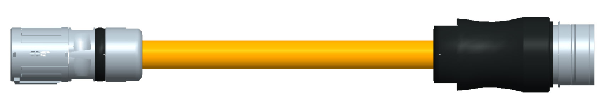
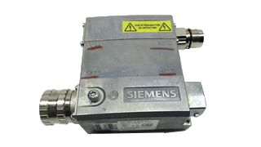
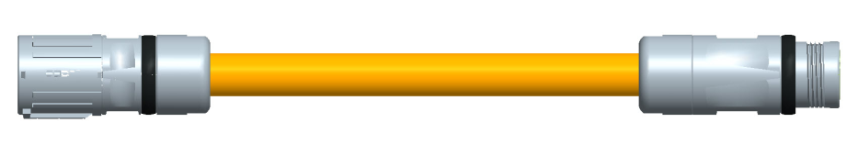
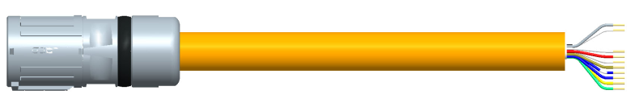
Product Portfolio – Connection- and Extension Cables
Integrated Measuring System - IMS
DC-LT/SCO
REG0011
RGS0008
Connection-Cable Rexroth
RKG0055
IndraDrive with EC Interface (12VDC)
Union Nut,
Socket
Standard Length:
0,5m 2m, 3m, 5m, 8m, 10m, 15m, 20m
M23, 17-Pin
Connection-Cable SIEMENS
RKG0071
Sensor Modules SME 25 / SME 125
REG0011
Outside Thread
Extension-Cable:
RKG0057
REG0011
REG0011
RKG0058, open ends
Single Connector
RGS1711
24
DC-LT/SCO3 | 14.01.2019
DC-LT/SCO3
© Bosch Rexroth AG 2019. All rights reserved, also regarding any disposal, exploitation, reproduction, editing, distribution, as well as in the event of applications for industrial property rights.

Slide 25
Product Portfolio – Technical Data
Integrated Measuring System - IMS
DC-LT/SCO
Parameter | Value |  | Notes
Voltage supply: | V_{DD}: 4,75 …. 24 V DC I_{MAX}: 300 mA |  | Overvoltage protection: ≤ 30V DC
Operating temperature range: | 0 °C .... 50 °C
Temperature range for storage / transport: | -10 °C ... 70 °C
Measuring speed: | 5 m/s |  | Additional dependency of guide element!
Protection type: | IP 67 |  | (tested with Curtis S90 cooling lubricant)
Maximum acceleration: | 500 m/s²
Shock: | 500 m/s² / 11 ms |  | According to EN 60068-2-27:1993 / IEC 68-2-6:1995
Vibration: | 100 m/s² |  | 55-2000Hz, according to EN 60068-2-6:1996 / IEC 68-2-6:1995
Electromagnetic compatibility: | Immunity to interference: Emitted interference: | EN 61326-1: 2006 EN 61000-6-2, Class B | CE mark RoHS and UL conform
25
DC-LT/SCO3 | 14.01.2019
DC-LT/SCO3
© Bosch Rexroth AG 2019. All rights reserved, also regarding any disposal, exploitation, reproduction, editing, distribution, as well as in the event of applications for industrial property rights.

Slide 26
IMS is the most accurate integrated measuring system available on market.
The system accuracy meets the specification of linear encoders with glass scales.
DC-LT/SCO
26
DC-LT/SCO3 | 14.01.2019
DC-LT/SCO3
© Bosch Rexroth AG 2019. All rights reserved, also regarding any disposal, exploitation, reproduction, editing, distribution, as well as in the event of applications for industrial property rights.

Slide 27
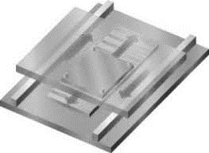
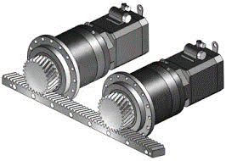


Where to use?
Integrated Measuring System - IMS
DC-LT/SCO
Kind of drive chains IMS is used for:
Linear motor
Ball screw
Belt drive
Rack and pinion
27
DC-LT/SCO3 | 14.01.2019
DC-LT/SCO3
© Bosch Rexroth AG 2019. All rights reserved, also regarding any disposal, exploitation, reproduction, editing, distribution, as well as in the event of applications for industrial property rights.

Slide 28


Where to use?
Integrated Measuring System - IMS
DC-LT/SCO
2D & 3D Laser cutting machines:
Linear motor in X- and Y-axis
X-axis as gantry
Y-axis carries laser cutters
IMS-I and IMS-A systems are used in many
different machine types from different laser cutting machine builders.
28
DC-LT/SCO3 | 14.01.2019
DC-LT/SCO3
© Bosch Rexroth AG 2019. All rights reserved, also regarding any disposal, exploitation, reproduction, editing, distribution, as well as in the event of applications for industrial property rights.

Slide 29



Where to use?
Integrated Measuring System - IMS
DC-LT/SCO
Machine Tool
Heller – DE
www.Heller.biz
5-Axis Machining Centre HF
New machine series for 2017:
HF 3500 / 5500
RSF Size 45 and 35
IMS is used for X-, Y- and Z-axis -> 3 IMS Systems per machine
Drive chain: ball screw assembly
29
DC-LT/SCO3 | 14.01.2019
DC-LT/SCO3
© Bosch Rexroth AG 2019. All rights reserved, also regarding any disposal, exploitation, reproduction, editing, distribution, as well as in the event of applications for industrial property rights.

Slide 30


Where to use?
Integrated Measuring System - IMS
DC-LT/SCO
Wood-Working Industry
Edge banding machine COMBINA
Edge processing unit KFA x50
(video: https://www.youtube.com/watch?feature=player_embedded&v=Tqb5lo5M9p0#t=139
-> IMS from 2:17 to 2:33)
Drive chain: linear motor
30
DC-LT/SCO3 | 14.01.2019
DC-LT/SCO3
© Bosch Rexroth AG 2019. All rights reserved, also regarding any disposal, exploitation, reproduction, editing, distribution, as well as in the event of applications for industrial property rights.

Slide 31


Where to use?
Integrated Measuring System - IMS
DC-LT/SCO
Wheelset machining – Underfloor wheelset lathe
IMS systems for measuring wear and the
diameter of wheel.
31
DC-LT/SCO3 | 14.01.2019
DC-LT/SCO3
© Bosch Rexroth AG 2019. All rights reserved, also regarding any disposal, exploitation, reproduction, editing, distribution, as well as in the event of applications for industrial property rights.

Slide 32

Where to use?
Integrated Measuring System - IMS
DC-LT/SCO
Automation systems for battery and display manufacturing systems
Example: modular system, based on Rexroth components:
IMS-I and IMS-A: BSHP size 25
Ball rail system BSHP
IndraDrive Cs
Linear motor MCP/MCS040
Drive chain: linear motor
32
DC-LT/SCO3 | 14.01.2019
DC-LT/SCO3
© Bosch Rexroth AG 2019. All rights reserved, also regarding any disposal, exploitation, reproduction, editing, distribution, as well as in the event of applications for industrial property rights.

Slide 33


Where to use?
Integrated Measuring System - IMS
DC-LT/SCO
Plotter Application:
Linear motor in X- and Y-axis
X-axis is a gantry configuration
Y-axis carries the plotter
33
DC-LT/SCO3 | 14.01.2019
DC-LT/SCO3
© Bosch Rexroth AG 2019. All rights reserved, also regarding any disposal, exploitation, reproduction, editing, distribution, as well as in the event of applications for industrial property rights.

Slide 34



Where to use?
Integrated Measuring System - IMS
DC-LT/SCO
PET Preform Injection systems
Machine-Type: IPS 220, IPS 400
The take-out robot is driven by latest-generation belt-free (and, therefore, maintenance-free) linear motors, ensuring accuracy, speed and repeatability of robot movements.
IMS-I ball rail system, Size 45
Rexroth linear motor MLP 100C-0190 and IndraDrive
Video: http://multimedia.sacmi.com/ABCENetMediaPlayer.aspx?src=/Streaming/SacmiImola/Plastics/Injection_Preforms_System.wmv&AutoPlay=1
-> take out robot with linear motor @ ~ 1min, 36s
34
DC-LT/SCO3 | 14.01.2019
DC-LT/SCO3
© Bosch Rexroth AG 2019. All rights reserved, also regarding any disposal, exploitation, reproduction, editing, distribution, as well as in the event of applications for industrial property rights.

Slide 35



Where to use?
Integrated Measuring System - IMS
DC-LT/SCO
Welding technology and automation
-> IMS used for quality control of process.
Process: CD-welding with high-current pulse Typical applications: Gear box parts, common rail, airbag inflator, seat recliner, etc.
IMS-A, roller rail system, size 35
Drive chain: ball screw assembly
35
DC-LT/SCO3 | 14.01.2019
DC-LT/SCO3
© Bosch Rexroth AG 2019. All rights reserved, also regarding any disposal, exploitation, reproduction, editing, distribution, as well as in the event of applications for industrial property rights.

Slide 36


Where to use?
Integrated Measuring System - IMS
DC-LT/SCO
Demonstration unit from Bosch Rexroth:
Small axis consists of:
Ironless linear motor
IMS-I / IMS-A runner block and rail, BSHP size 20
Mechanical assembly
36
DC-LT/SCO3 | 14.01.2019
DC-LT/SCO3
© Bosch Rexroth AG 2019. All rights reserved, also regarding any disposal, exploitation, reproduction, editing, distribution, as well as in the event of applications for industrial property rights.

Slide 37
IMS can be used for many different applications in different branches.
Integrated + Precise + Robust
DC-LT/SCO
37
DC-LT/SCO3 | 14.01.2019
DC-LT/SCO3
© Bosch Rexroth AG 2019. All rights reserved, also regarding any disposal, exploitation, reproduction, editing, distribution, as well as in the event of applications for industrial property rights.

Slide 38
TCO - total cost of ownership
Integrated Measuring System IMS
DC-LT/SCO
Importance
Purchase Prize
Cost of Assembly
Cost of Adjustment
Energy consumption
Maintenance
Disassembly, Disposal Fees
Machine builder - OEM
depends on volume
Machine enduser
depends on volume
38
DC-LT/SCO3 | 14.01.2019
DC-LT/SCO3
© Bosch Rexroth AG 2019. All rights reserved, also regarding any disposal, exploitation, reproduction, editing, distribution, as well as in the event of applications for industrial property rights.

Slide 39





TCO - total cost of ownership
Integrated Measuring System - IMS
DC-LT/SCO
Space Saving
Easy Installation
Protection Class
TCO Calculation Tool
-> Allows simple machine designs due to the full integration
-> No additional space required
-> Elimination of stop and mounting surfaces
-> Minimum mounting time: the guide assembly is mounted at the same time as the measuring system
-> No adjustment of the measuring system
-> No need for additional components
IP 67
ON
BOARD
-> Elimination of all sealing air components and installations like hoses, pressurized air and their service (filter change)
-> Very good protection against damage
€
-> Usage of IMS leads to savings in designing, installation and service purposes
-> Savings can be calculated with the TCO Tool
39
DC-LT/SCO3 | 14.01.2019
DC-LT/SCO3
© Bosch Rexroth AG 2019. All rights reserved, also regarding any disposal, exploitation, reproduction, editing, distribution, as well as in the event of applications for industrial property rights.

Slide 40


TCO - total cost of ownership
Integrated Measuring System - IMS
DC-LT/SCO
Example:
Grinding machines for profiled guide rails in Schweinfurt plant
Problem:
Sealed linear encoders (glass scale) cause downtime of machine and regular cost for maintenance (cleaning glass scale) due to contamination from grinding process.
Solution:
Retrofitting old grinding machines by using IMS systems instead of sealed linear encoders.
Benefits:
Cost savings of approx. 10K€ per machine due to reduced downtime of machine and no maintenance for IMS.
40
DC-LT/SCO3 | 14.01.2019
DC-LT/SCO3
© Bosch Rexroth AG 2019. All rights reserved, also regarding any disposal, exploitation, reproduction, editing, distribution, as well as in the event of applications for industrial property rights.

Slide 41
Purchase price is only one part of TCO.
The real savings can be identified by calculating all relevant TCO topics.
DC-LT/SCO
41
DC-LT/SCO3 | 14.01.2019
DC-LT/SCO3
© Bosch Rexroth AG 2019. All rights reserved, also regarding any disposal, exploitation, reproduction, editing, distribution, as well as in the event of applications for industrial property rights.

Slide 42
Thank you!
42
DC-LT/SCO3 | 14.01.2019
DC-LT/SCO3
© Bosch Rexroth AG 2019. All rights reserved, also regarding any disposal, exploitation, reproduction, editing, distribution, as well as in the event of applications for industrial property rights.

